Slide 1

Essential Digital Skills Workforce Programme
Vikki liogier
@vikkiliogier
#EnhanceEDS
BLC
27 March 2020

Slide 2

today
01
02
03
04
05
06
ETF’s Mission and Values
CONTEXT
Essential digital skills standards
EDS WORKFORCE DEVELOPMENT PROGRAMME
Accessibility & Inclusion
Conclusion

Slide 3
01
ETF’s Mission & Values

Slide 4

What is the Education and Training Foundation?
We are the government-backed, sector-owned national support body for the Further Education and Training sector.
Our Mission and Values
The Education and Training Foundation works with teachers, trainers, leaders and employers to help them deliver excellent further and vocational education and training.

Slide 5
02
Context

Slide 6

Context
In-depth positioning review performed early 2018.
Three key points:
​
1- Clear awareness that digital skills and technologies must be harnessed for the UK to remain a global leader;​
    The UK digital Strategy (March 2017); ​
    The UK Industrial strategy – Building a Britain Fit for The Future;​
    FELTAG Recommendations (March 2014) & Evolution (June 2016)​
    The 2020 Essential Digital Skills Entitlement;​
    DfE EdTech Strategy (April 2019)
​

Slide 7
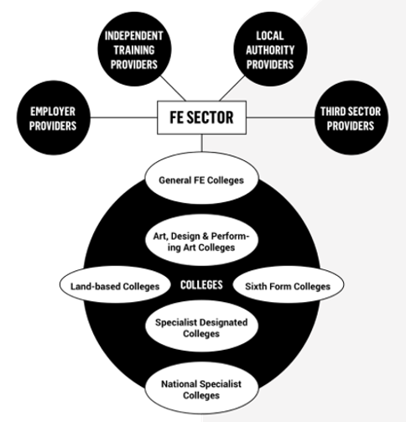
2- Diversity and complexity of the vocational & training
sector’s landscape
types of providers IN FE

Slide 8

Lloyds Bank UK Consumer Digital Index 2019
Strategy to tackle the barriers to digital & the digital divide
11.9 million
adults do not have the essential digital skills they need for life
22%
17.3 million
of working age adults do not have the essential digital skills they need for work
53%
Notes:
Although we live in an increasingly online world, a significant part of the population remains digitally excluded. One in 10 adults has never used the internet¹⁴ and many more are missing out on the opportunities the digital world offers, whether through lack of connectivity, digital skills or motivation. We must continue to address this digital divide between those who have been able to embrace the digital world and those who have not.

Slide 9
03
EDS STANDARDS

Slide 10



Slide 11


Slide 12


Slide 13


Slide 14
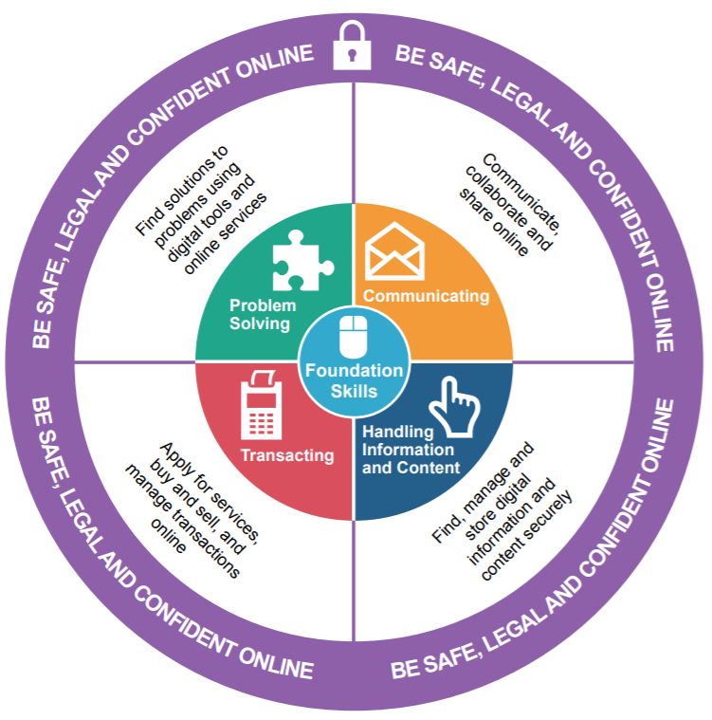
New national standards for EDS
2006 ICT Standards
Use ICT systems select, interact use ICT systems Follow safety and security practices
Find & exchange information Select and use appropriate sources of information Search for, select and develop ICT based information Use ICT to communicate and exchange information
Developing & presenting info Enter, organise, develop and format text/ tables/ images/ numbers/ records Evaluate different methods of organising and presenting information
New topics?
Online communication (not just email)
Digital footprint
Buying securely online
Storing and accessing files from the cloud
Being responsible online
Understanding rights under data protection law

Slide 15
EDS Framework
5
EDS categories for
life and work
• Communicating
• Handling information & content
• Transacting
• Problem Solving
• Being safe and legal online

Slide 16



Slide 17


Slide 18


Slide 19
04
EDS workforce Development Programme

Slide 20

Context
ETF commissioned by DfE to develop a workforce development programme
The programme is mapped to the national standards.
Informed by Research on the
    Workforce Capability to Deliver the Digital Entitlement
    conducted between November 2018 & February 2019
    across 76 organisations.
Notes:
https://assets.publishing.service.gov.uk/government/uploads/system/uploads/attachment_data/file/796596/National_standards_for_essential_digital_skills.pdf
The standards set out the digital skills needed for work and life across two skills levels
Entry – adults with nor or little prior experience of using digitial devices or the internet
Level 1 – adults with some experience of using digital devices and the internet but lacking secure basic digital skills

Slide 21

Programme structured around a Blended CPD Training with 4 modes of delivery
Move away from a linear structured programme and user experience is at the heart of the design
1. Online
Self-assessment tool with pointers to microlearning modules to fill skills gaps
SA will capture the learner’s journey in a timely manner and update its EDS capability profile
A set of short learning modules to best respond to the differentiated spiky skills gap profile of practitioners
Gamification used to motivate, reward and acknowledge progress with Badging.

Slide 22
Programme structured around a Blended CPD Training with 4 modes of delivery
2. Face to Face Workshops / Webinars
Confidence builders and “How to” workshops
Planned to roll out across organisations
through peer training
3. Multimedia Toolkit
Confidence – Scenario exemplars of activities to be
used with students
Guidance material
Team meetings support and organisational guidance
4. Communities of practice
Peer/pathway/sector support
Sustainability
Ongoing share of practices

Slide 23


Slide 24
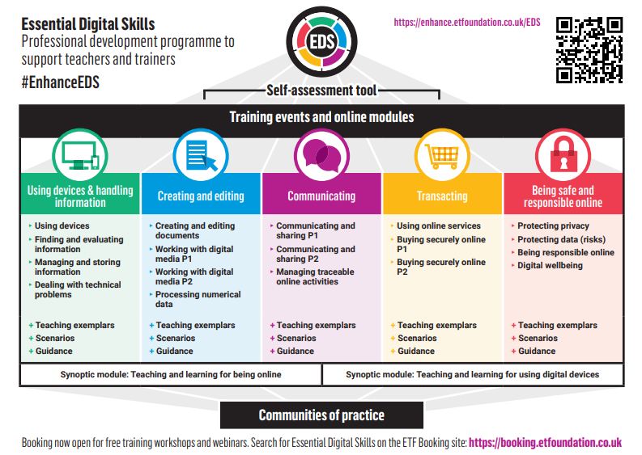

Slide 25






BADGES
Complete one of the 5 skill areas to get a badge
Complete all 5 skill areas – get the full badge

Slide 26

Notes:
Video transcript: Introduction
The Department for Education has commissioned the Education and Training Foundation to deliver a professional development programme to support the introduction of the new essential digital skills entitlement.
The aim of the programme is to prepare teachers, trainers, assessors and leaders to deliver the new qualifications based on the standards.
The programme has been co-designed with representatives of all parts of the FE and Training Sector. It is structured around a blended training model with four modes of delivery:
An interactive self-assessment tool to identify training needs, linked to training modules to respond to the differentiated spiky skills gap profiles of practitioners
A series of 20 short online learning modules with teaching exemplars and advice on teaching contexts, as well as digital badges to recognise achievement
Face-to-face training and online webinars to build confidence and share practice related to different teaching contexts
Online communities of practice to offer peer-to-peer support
The online elements of the programme are hosted on the ETF’s Enhance Digital Teaching Platform.
All elements of the programme are fully subsidised so there is no charge to FE and Training sector organisations.
Who is this for?
The programme is for all types of staff – teachers, trainers, assessors and managers, who will be involved in delivering Essential Digital Skills training at Entry and Level 1 including those from:
Adult Community Learning Services
ESOL
Offender Learning
Pathways for Life and Work
SEND
It is anticipated that the programme will be particularly helpful for those teachers and trainers who are not ICT specialists but rather will deliver digital skills training as part of another learning programme such as ESOL or Preparation for Life and Work.
Toolkit
The programme includes a toolkit designed to provide a gateway to the programme. Its purpose is to help you to get the best from the programme for your specific needs.
In the body of this toolkit you will find a section on each element of the programme, with links to walkthrough videos. It also includes a section on how to cascade training in your organisation with resources to help you do that.
The toolkit is available online on the Essential Digital Skills menu on the Enhance Digital Teaching Platform.
To find out more, visit: www.enhance.etfoundation.co.uk

Slide 27




New Walkthrough Video https://youtu.be/r7jJOYiHmzI

Slide 28
05
Accessibility & Inclusion

Slide 29
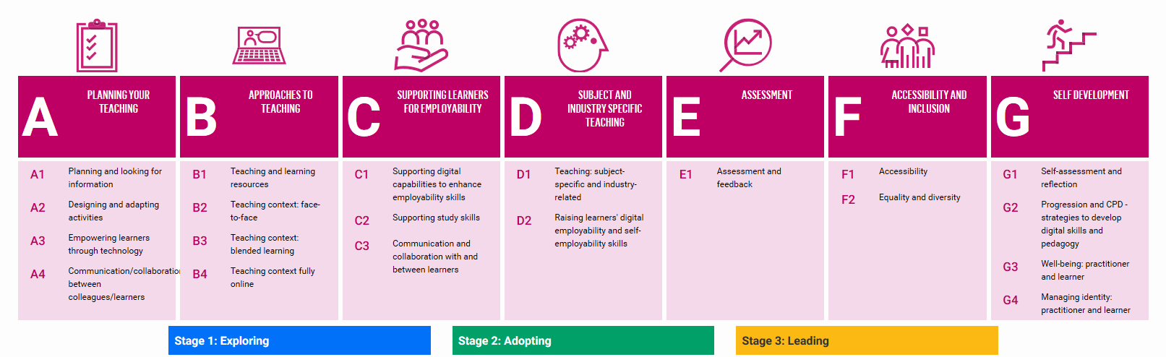
Digital Teaching Professional Framework
#DTPF
Slides from an online webinar delivered by Sally Betts and Alistair McNaught
Notes:
The Digital Teaching Professional Framework (DTPF) is a national EdTech competency framework which underpins the EdTech training offer. It provides a set of professional standards for technology-enhanced learning and aims to establish a common understanding of digital skills development.
There are seven elements to the DTPF with progression over three levels: Exploring, Adopting and Leading. With a wide range of bite-size training modules that can support you in developing your pedagogy using technology. Today we are focusing on section F of the framework Accessibility and inclusion.

Slide 30
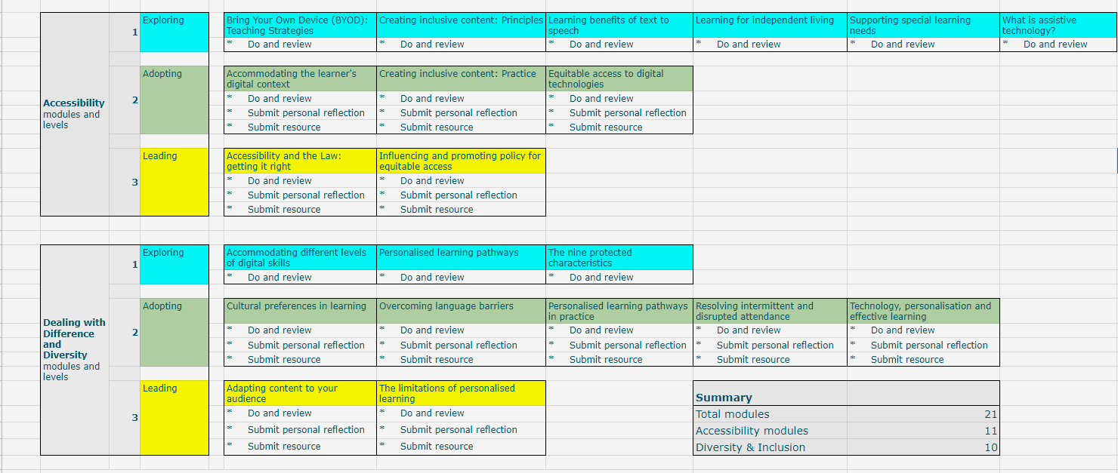
Modules
Slides from an online webinar delivered by Sally Betts and Alistair McNaught
Notes:
These are some of the modules that can support delivery online. It is important to consider accessibility and inclusion with any online delivery.

Slide 31



Embed Learning
Complete a cluster of modules
  Awarded a 1 star badge
Reflect on how you have/intend to change your practice
Awarded a 2 star badge
Upload a resource and reflection showing your newly adopted practice
Awarded a 3 star badge
Slides from an online webinar delivered by Sally Betts and Alistair McNaught
Notes:
A badge is a way of evidencing that you’ve taken some learning and applied it to your role and teaching practice. You can add them to both FB and LinkedIn profiles.
Let’s look at the badging process – badges are available on the EdTech Platform for the Accessibility and Dealing with difference modules, it is in the pilot phase so you will be supporting the development of the platform by completing a badge or badges by the 30th March, that can then help to inform the roll out of the badge process.
Point out that you can study the modules in any order – the stages are there to support you and guide you but if a module is of interest right now then it can be studied separately.
Looking at Accessibility – Stage Adopting - you complete the cluster of badges (click on bullet point to see Accessibility clusters)
You are automatically awarded a 1 star badge (click on bullet to show one star badges)
You could gain our new higher level awards by sharing your reflections and resources.
To gain a 2 star badge reflect on how the learning has supported you to change your practice and the impact for you and your learners.
To gain a 3 star badge at Adopting level, upload a resource and reflection that demonstrates your change in practice and the impact for you and your learners.

Slide 32



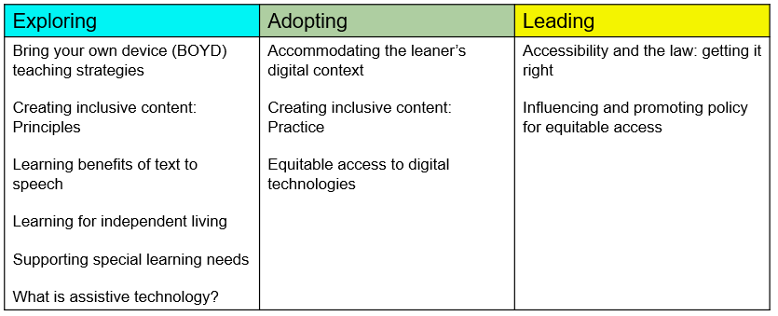



Embed Learning
Similar process across stages
Slides from an online webinar delivered by Sally Betts and Alistair McNaught
Notes:
Similar across all badges but note there is no uploading on the Exploring stage; you’re finding out about things here, thinking about things in preparation for changing your practice.
When you login in and look at your My Learning area you will see badges that you could work towards.

Slide 33


Slide 34
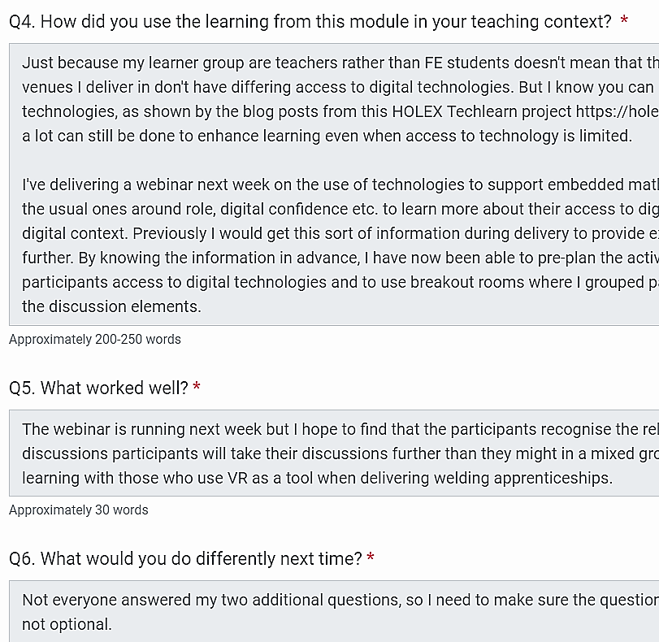
Why? 1
You do...
Practice
Reflection
Metacognition
Growth mindset.
Slides from an online webinar delivered by Sally Betts and Alistair McNaught
Notes:
Why do a badge?
You do the following and that consolidates your learning...
Practice
Reflection
Metacognition
Growth mindset.
You get the following in return and that enhances your understanding...
Supportive feedback.
Caveats and suggestions.
Highlight it’s scaffolded through questions and by giving an indication of word count.

Slide 35
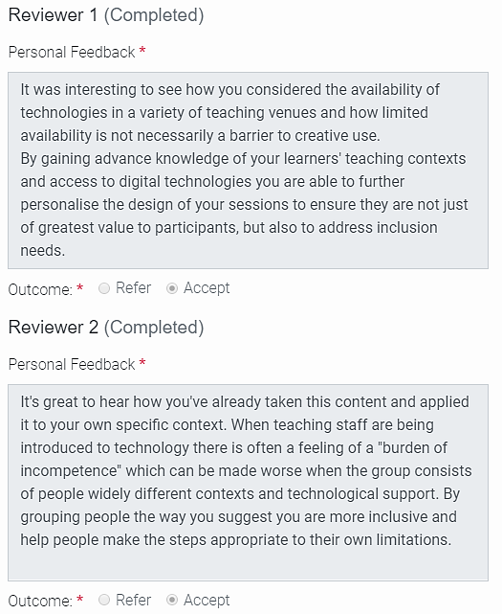
Why? 2
You get...
Supportive feedback.
Caveats and suggestions.
Slides from an online webinar delivered by Sally Betts and Alistair McNaught
Notes:
Why do a badge?
You do the following and that consolidates your learning...
Practice
Reflection
Metacognition
Growth mindset.
You get the following in return and that enhances your understanding...
Supportive feedback.
Caveats and suggestions.

Slide 36
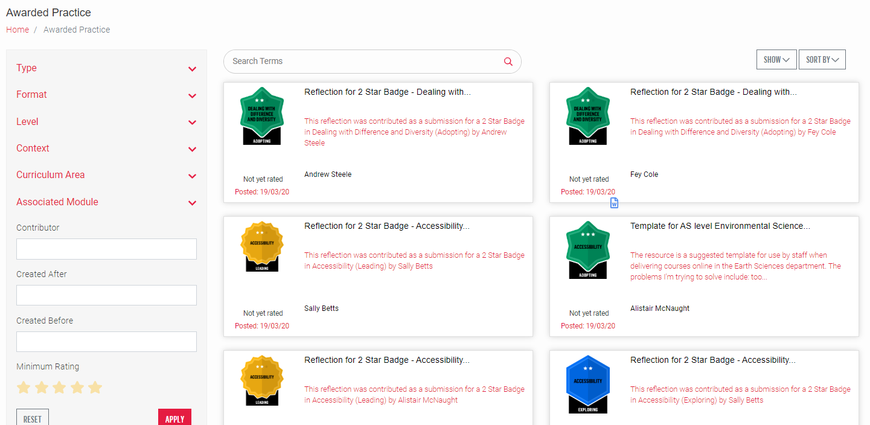

Seeing others' reflections & resources
https://enhance.etfoundation.co.uk/resourcebank/
Slides from an online webinar delivered by Sally Betts and Alistair McNaught
Notes:
Image to be changed – before webinar.
Show the shared area the next steps to build a place where you can look and discuss ideas and practice based on the reflections and resources uploaded by other practitioners. The area is being developed with search features to help you to find things of interest to you.

Slide 37


Slide 38
06
Conclusion

Slide 39

Visit #EnhanceEDS
www.enhance.etfoundation.co.uk

Slide 40
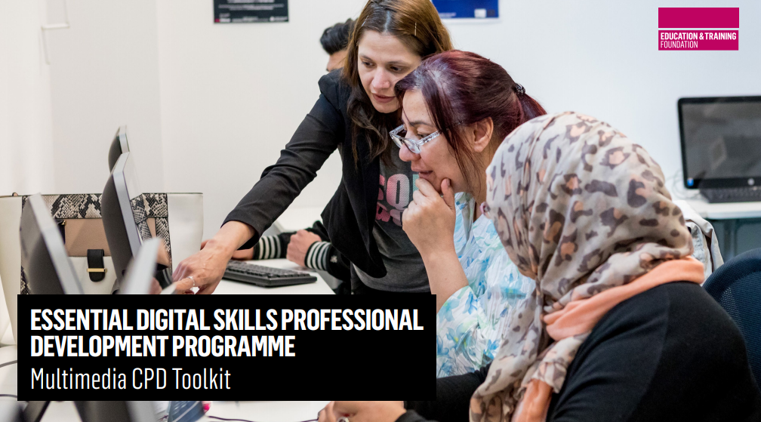

https://qrgo.page.link/K8kc1

Slide 41




https://www.et-foundation.co.uk/news/new-series-of-free-webinars-to-support-online-learning/
https://www.et-foundation.co.uk/edtech

Slide 42
Vikki liogier
vikki.liogier@etfoundation.co.uk
https://www.et-foundation.co.uk/edtech

Slide 43

Visual References
Images sourced from Pexels free stock photos bank: https://www.pexels.com/
Contributors include:
Victor Freitas - https://www.pexels.com/photo/black-metal-framed-pendant-lamp-turned-on-973510/
George Becker - https://www.pexels.com/photo/bright-bulb-close-up-electricity-383673/
Juhasz Imre - https://www.pexels.com/photo/bright-buildings-clear-close-up-425183/
Lukas - https://www.pexels.com/photo/ball-shaped-bright-bulb-burnt-296323/
Carl Attard - https://www.pexels.com/photo/blur-design-drink-electricity-420315/
Mikael Roh - https://www.pexels.com/photo/photo-of-two-turned-on-bulbs-799611/
Isaque Pereira - https://www.pexels.com/photo/arrows-close-up-dark-energy-394377/
Pixabay - https://www.pexels.com/photo/2-pendant-lamps-turned-on-159108/ &
…...................https://www.pexels.com/photo/light-glass-lamp-idea-2396/

Slide 44
11.9 million (22%) adults do not have the essential digital skills they need for life
Education- 91% of those with university formal degrees have EDS for life, compared to 35% with no formal education.
Age- 94% of those aged 18-24 years old have EDS life, compared to 45% of those aged 65 plus.
Disability- 82% without a disability have EDS for life, compared to 53% with a disability.
Gender- 80% of men have EDS for life, compared to 75% of women.
Household income- 89% of those with household incomes of £25k or more have EDS for life, compared to 57% with household incomes under £11.5k.
Employment- 90% of full time workers have EDS for life, compared to 64% not working.
Source: Lloyds Bank UK Consumer Digital Index 2019

Slide 45
17.3 million (53%) of working age adults do not have the essential digital skills they need for work
Those with EDS for work earn on average £37,995 per year- almost £13,000 more than those lacking workplace digital skills.
Significant variation by sector e.g. 80% of the finance, insurance and real estate workforce have EDS for work, compared to 36% of the manufacturing workforce.
Examples of EDS for work:
  48% of those in work cannot use digital collaboration tools
  43% of those in work cannot use software such as spreadsheets to manipulate and analyse data
  33% lack cyber security skills.
Source: Lloyds Bank UK Consumer Digital Index 2019
Source: Lloyds Bank UK Consumer Digital Index 2019

